Slide 1


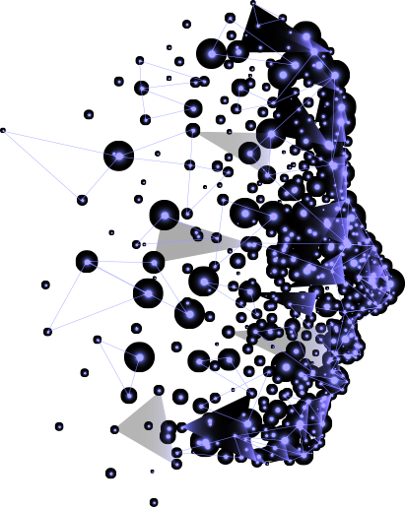







Agentic AI
Transforming Automation & Intelligence

Slide 2

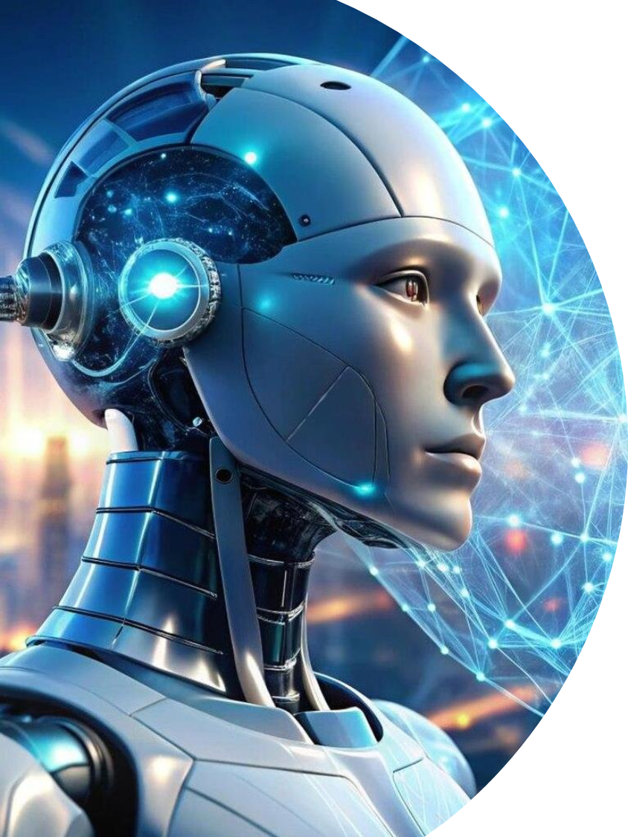

What is Agentic AI
Agentic AI integrates large language models (LLMs), machine learning, and enterprise automation to create autonomous AI agents capable of decision-making, goal-setting, problem-solving, and adapting to unstructured environments, unlike rule-based AI.

Slide 3



Agentic AI Vs. Generative AI
Agentic AI
Generative AI
Autonomous
Creative
Goal-Oriented
Output-Oriented
Real-time Environment
Content-Based
Vs
Utilize Tools and APIs
No external tools
Continuous Adaptation
No adaptation from real-time
Autonomous Systems
Content Creation
Independent Decision-Making
Make decision based on input patterns

Slide 4







Evolution of Agentic AI
Early AI Models
Focused on predefined rules and automation.
Machine Learning Era
AI began adapting and learning patterns.
Rise of Large Language Models (LLMs)
Enhanced contextual understanding.
Agentic AI Integration
Combining AI, automation, and real-time adaptability.

Slide 5
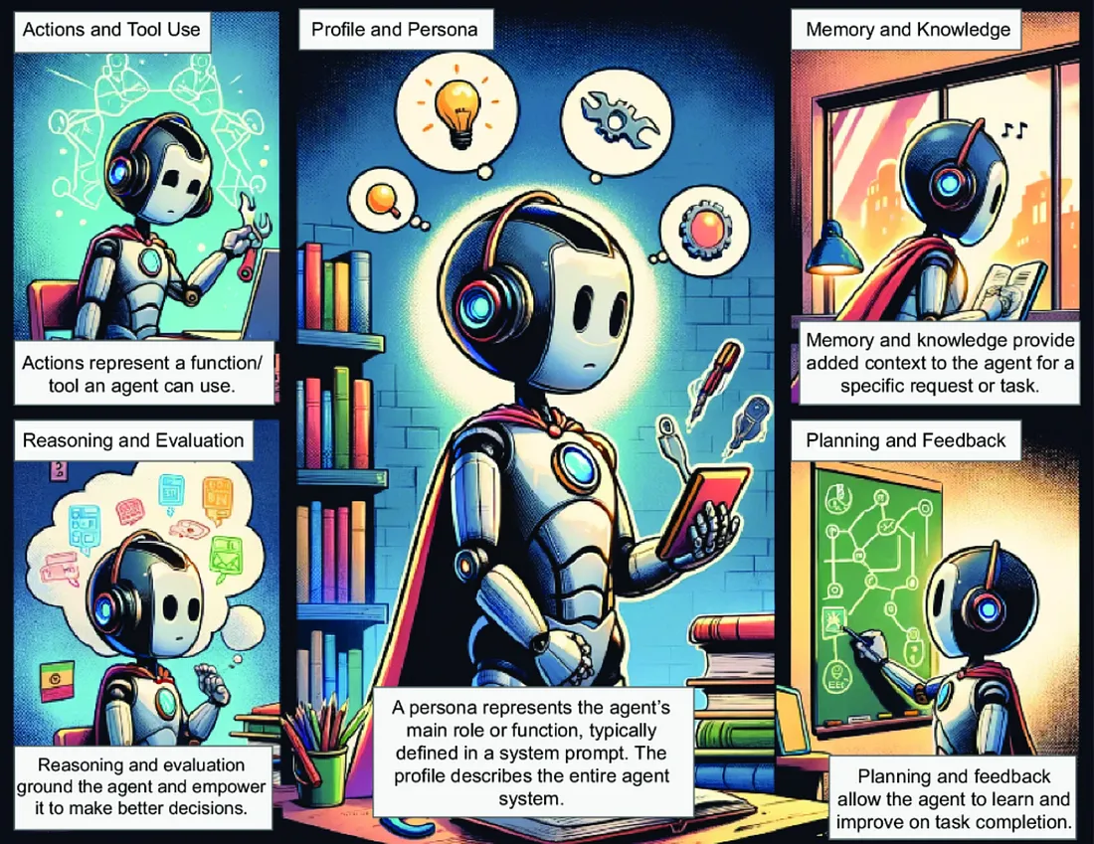
CORE COMPONENTS

Slide 6






How Agentic AI Works
Understanding
AI processes data using LLMs and machine learning.
Goal-Setting
Identifies objectives and plans strategies.
Execution
Automates tasks with minimal human input.
Learning
Continuously improves through interactions.

Slide 7
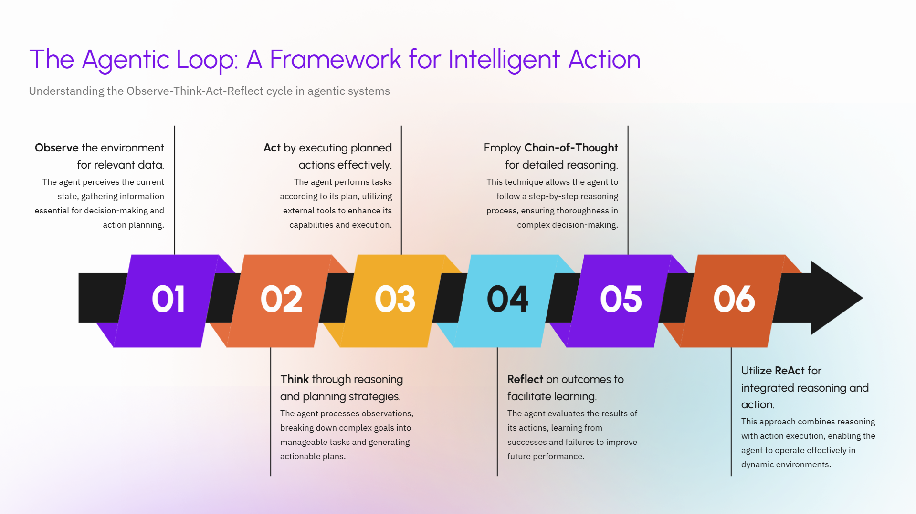

Slide 8


Perception
Agentic AI System
Multi-modal fusion
Camera
Text
Audio
Sensors
Cognition
Memory
Decision making
Knowledge Base
User Request
Al Agent
Action
Executing Tasks
Physical actions in real-world
Monitors

Slide 9


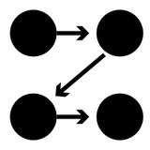

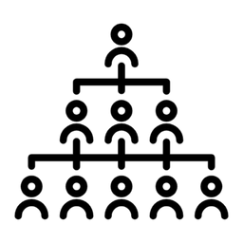

Design Patterns in Multi-Agent Systems
Parallel: Agents work on different parts at the same time, like processing text and images together.
Loop: An agent repeats a task until done, like refining a solution.
Sequential: Agents take turns, like cleaning data then analyzing it.
Router: One agent directs tasks to others, like routing customer queries.
Network: Agents are connected like a web, sharing information.
Hierarchical: Agents have levels, like executives giving goals to managers.

Slide 10

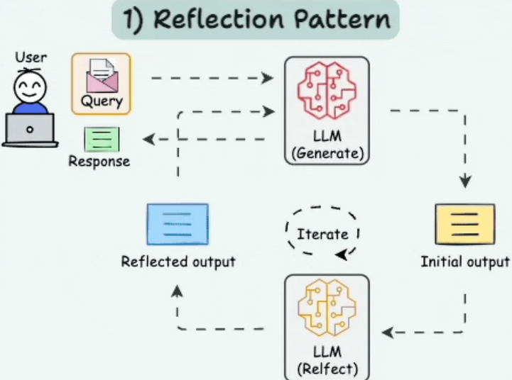
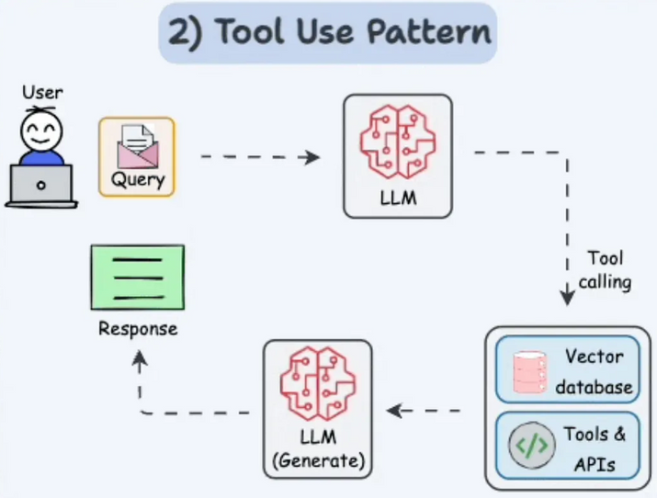

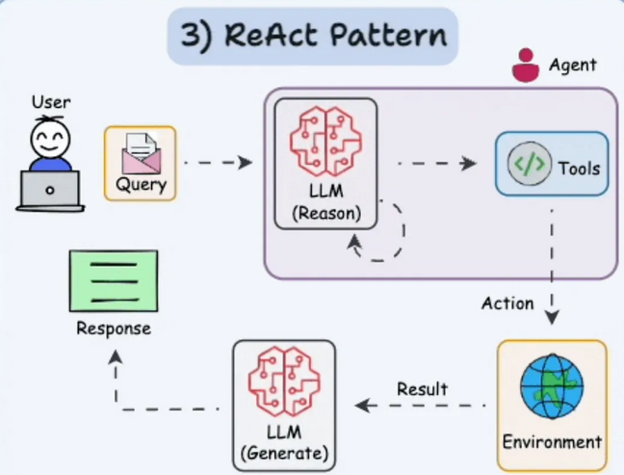
More patterns

Slide 11
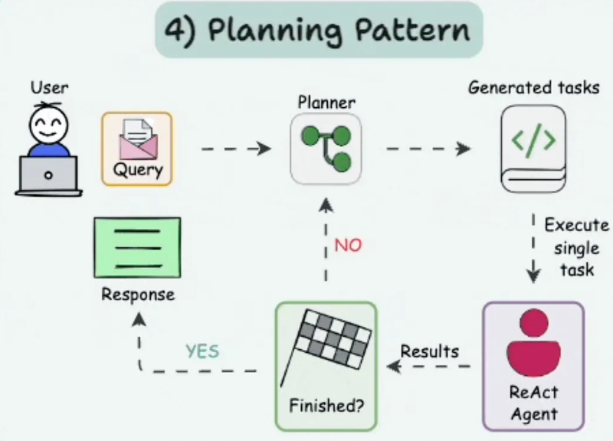
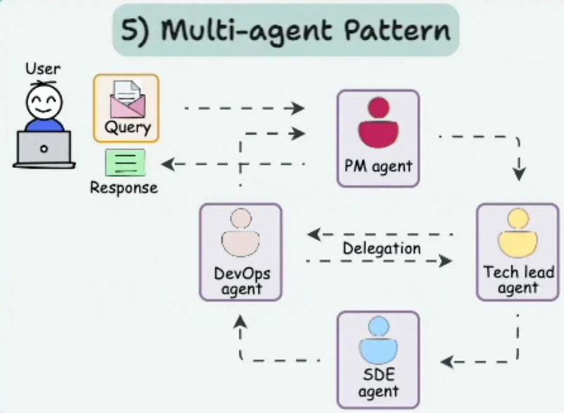
More patterns

Slide 12
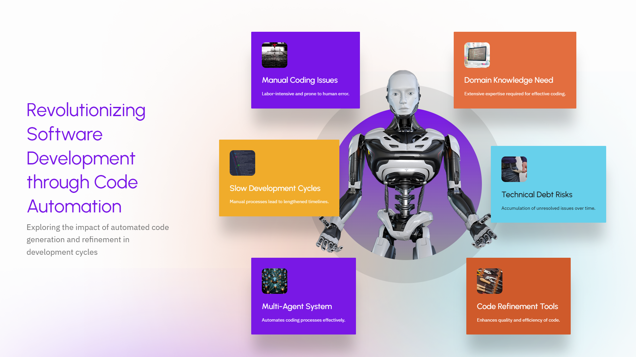

Slide 13
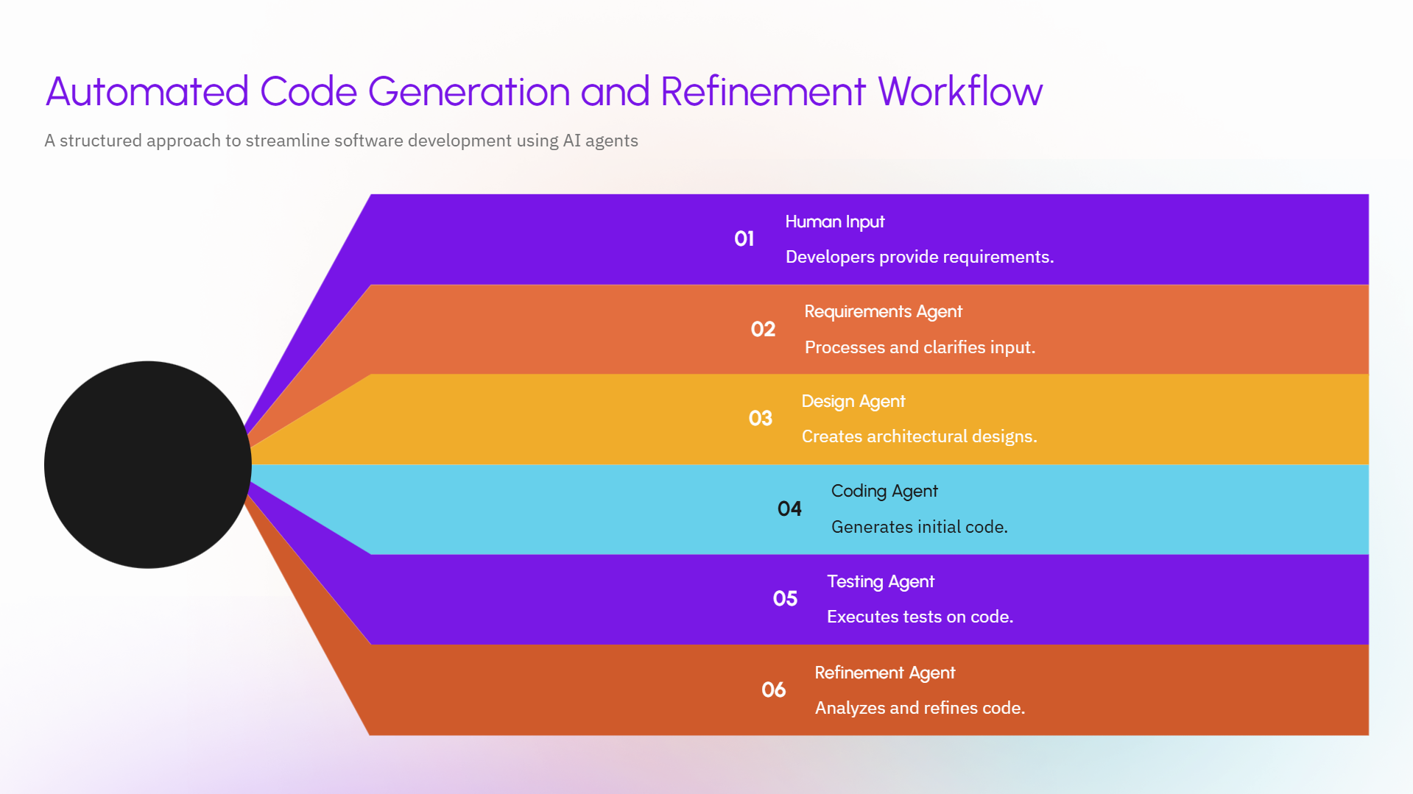

Slide 14
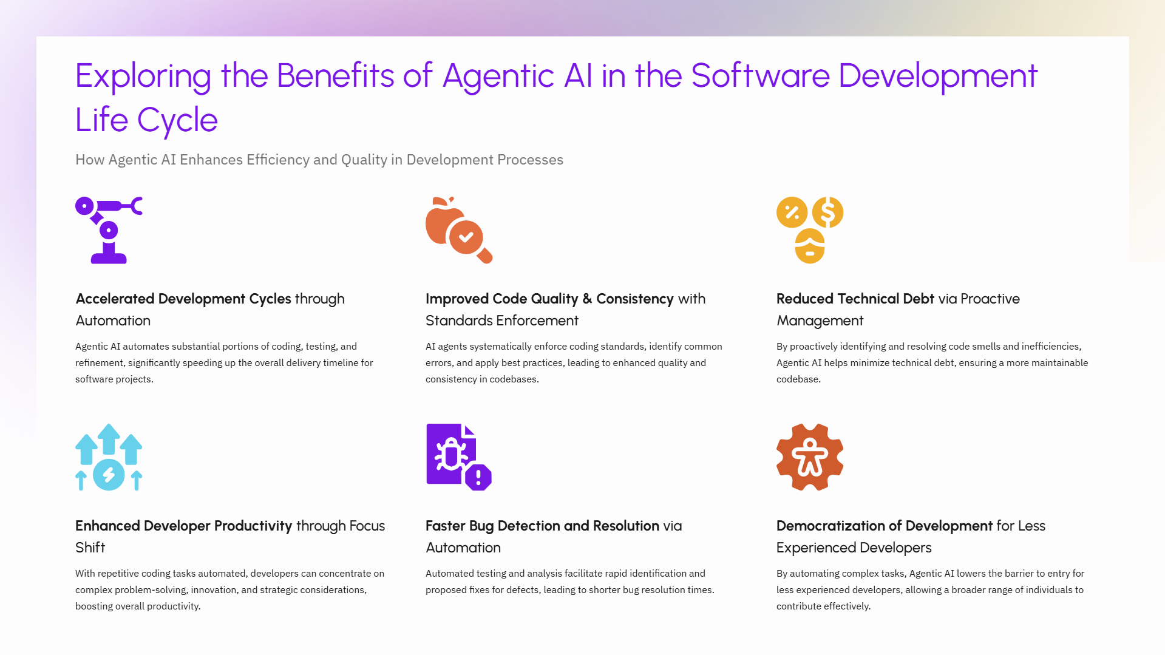

Slide 15
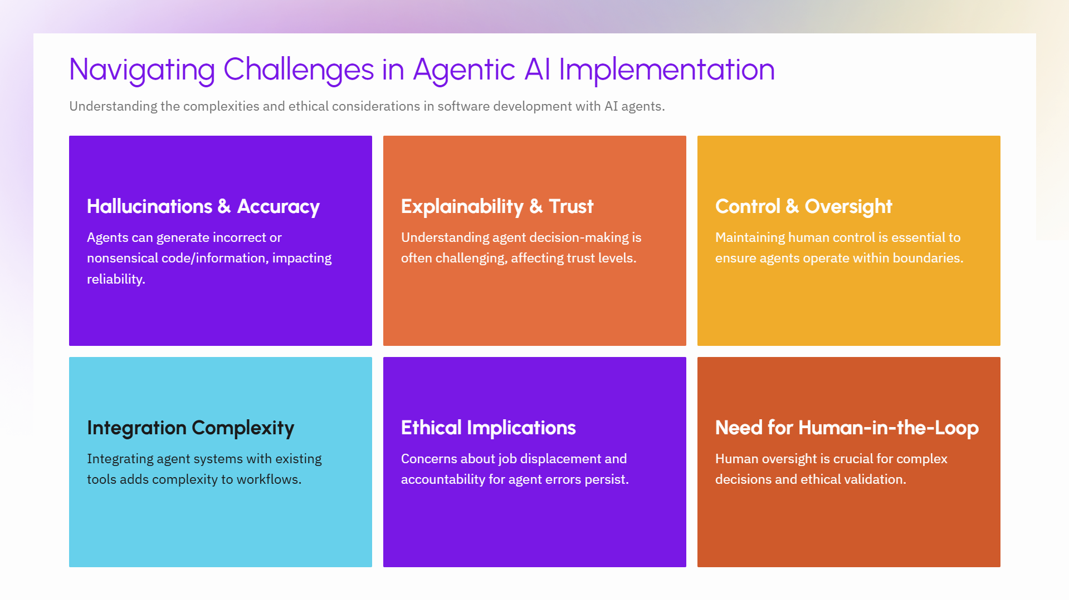

Slide 16




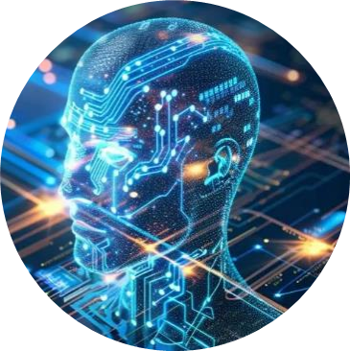
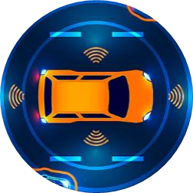
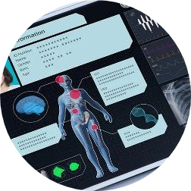

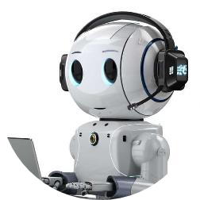

Applications Of Agentic AI
Autonomous Vehicles
Healthcare
Finance
Customer Service
Advanced driver
assistance systems
Electronic health records
Customer relationship management systems
Sentiment analysis chatbot

Slide 17
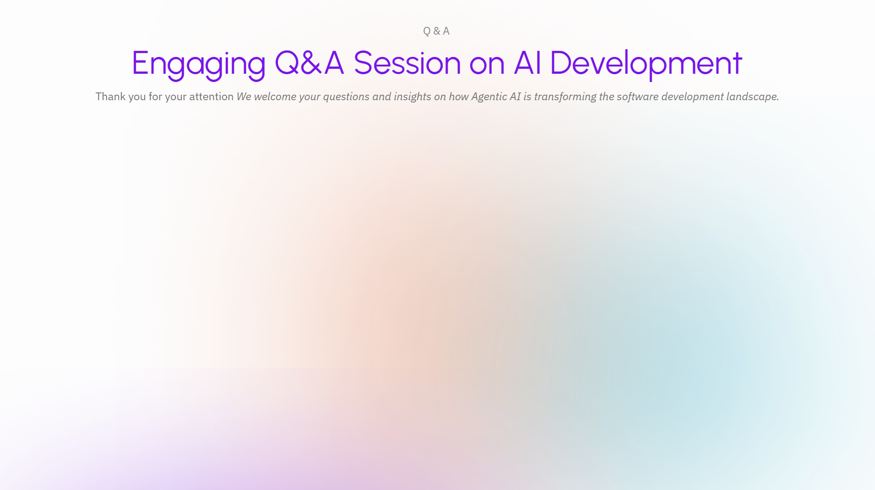
Tools and Frameworks
LangChain: Great for creating chatbots that can use tools like web searches.
LlamaIndex: Helps connect AI to company data for smarter decisions.
AutoGen: Allows multiple AI agents to work together, like a team solving complex problems.

